Slide 1
Linux、Windows
Scheduling
PRESENTED BY Ian

Slide 2
PART ONE
Linux Scheduling

Slide 3
PART ONE
SCHED_FIFO/SCHED_RR
SCHED_OTHER／SCHED_NORAML
First-in-first-out real-time threads／
Round-robin real-time threads
实时进程调度只决定于一种优先级RT Priority
[0,MAX_RT_PRIO-1]
优先级不会改变
缺省值0，表示非实时进程
Other, non-real-time threads
非实时进程有三种优先级
Static priority
Normal priority
Dynamic priority
[MAX_RT_PRIO-1,MAX_PRIO-1]
01
02
struct task_struct { …… int prio, static_prio, normal_prio; unsigned int rt_priority; …… };

Slide 4
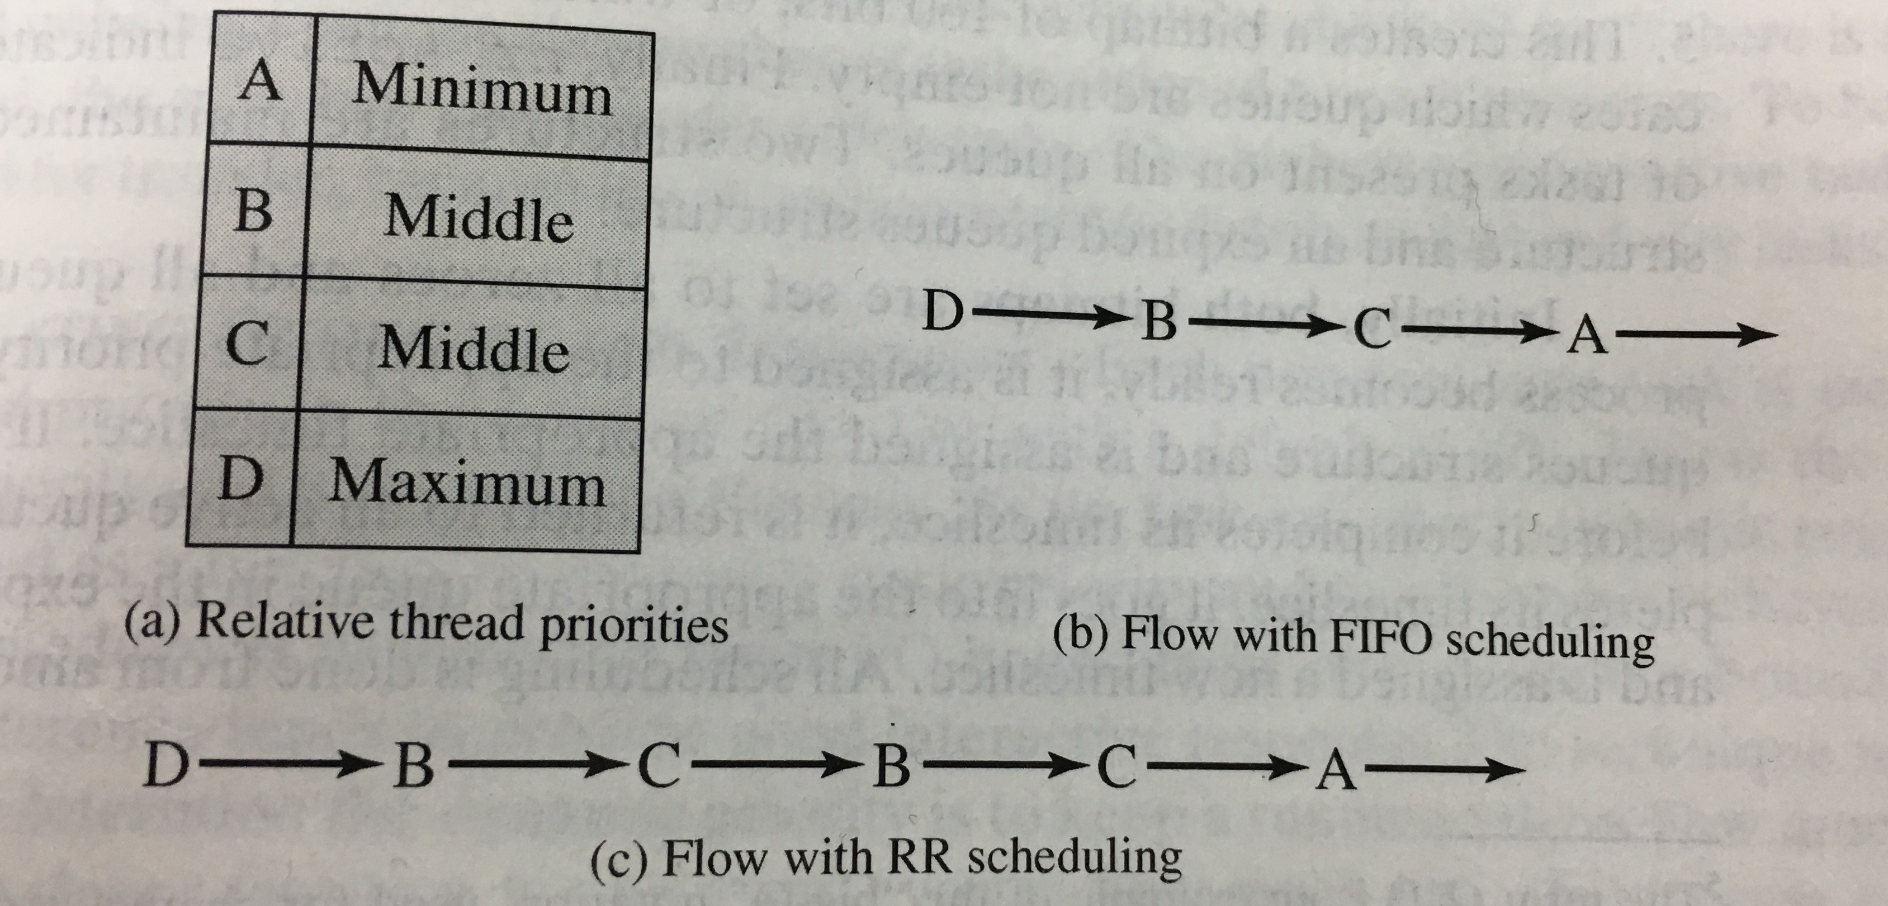
PART ONE
SCHED_FIFO/SCHED_RR
实时进程的优先级总是高于非实时进程。
对于FIFO的进程，意味着只有当前进程执行完毕才会轮到其他进程执行。
对于RR的进程，一旦时间片消耗完毕，则会将该进程置于队列的末尾，然后运行其他相同优先级的进程，如果没有其他相同优先级的进程，则该进程会继续执行。
Figure Example of Linux Real-Time Scheduling

Slide 5
PART ONE
SCHED_FIFO/SCHED_RR
实时进程被一个进程替换，可能的情况有：
进程被拥有更高优先级的进程抢占。
进程发生阻塞进入睡眠状态。
进程被终止（状态为TASK_STOPPED OR TASK_TRACED）或者被杀死（EXIT_DEAD OR EXIT_ZOMBIE）。
进程通过调用sched_yield()自愿放弃处理器。
进程是轮回实时（SCHED_RR）且其时间片执行完毕。
PLUS. 当在SCHED_RR时调用nice()和set_priority()函数并不影响实时优先级，只会影响静态优先级（从而影响基时间片）

Slide 6
PART ONE
SCHED_OTHER／SCHED_NORAML
Linux对普通的进程，根据动态优先级进行调度。而动态优先级是由静态优先级调整而来。
Linux下，静态优先级是用户不可见的，隐藏在内核中。
内核提供给用户一个可以影响静态优先级的接口，那就是nice值，两者关系如下：
static priority = nice + 20 + MAX_RT_PRIO. (nice取值范围为[-20,19]，缺省值0)
nice数值越大就使得static priority越大，最终进程优先级就越低。
Linux2.6认为，交互式进程可以从平均睡眠时间进行判断。
进程过去的睡眠时间越多，则越有可能属于交互式进程。
则系统调度时，会给该进程更多的奖励（bonus），以便该进程有更多的机会能够执行。
奖励（bonus）从0到10不等。
动态优先级计算公式：
dynamic priority = max (100, min (static priority - bonus + 5, 139))
时间片（time slice）计算公式

Slide 7
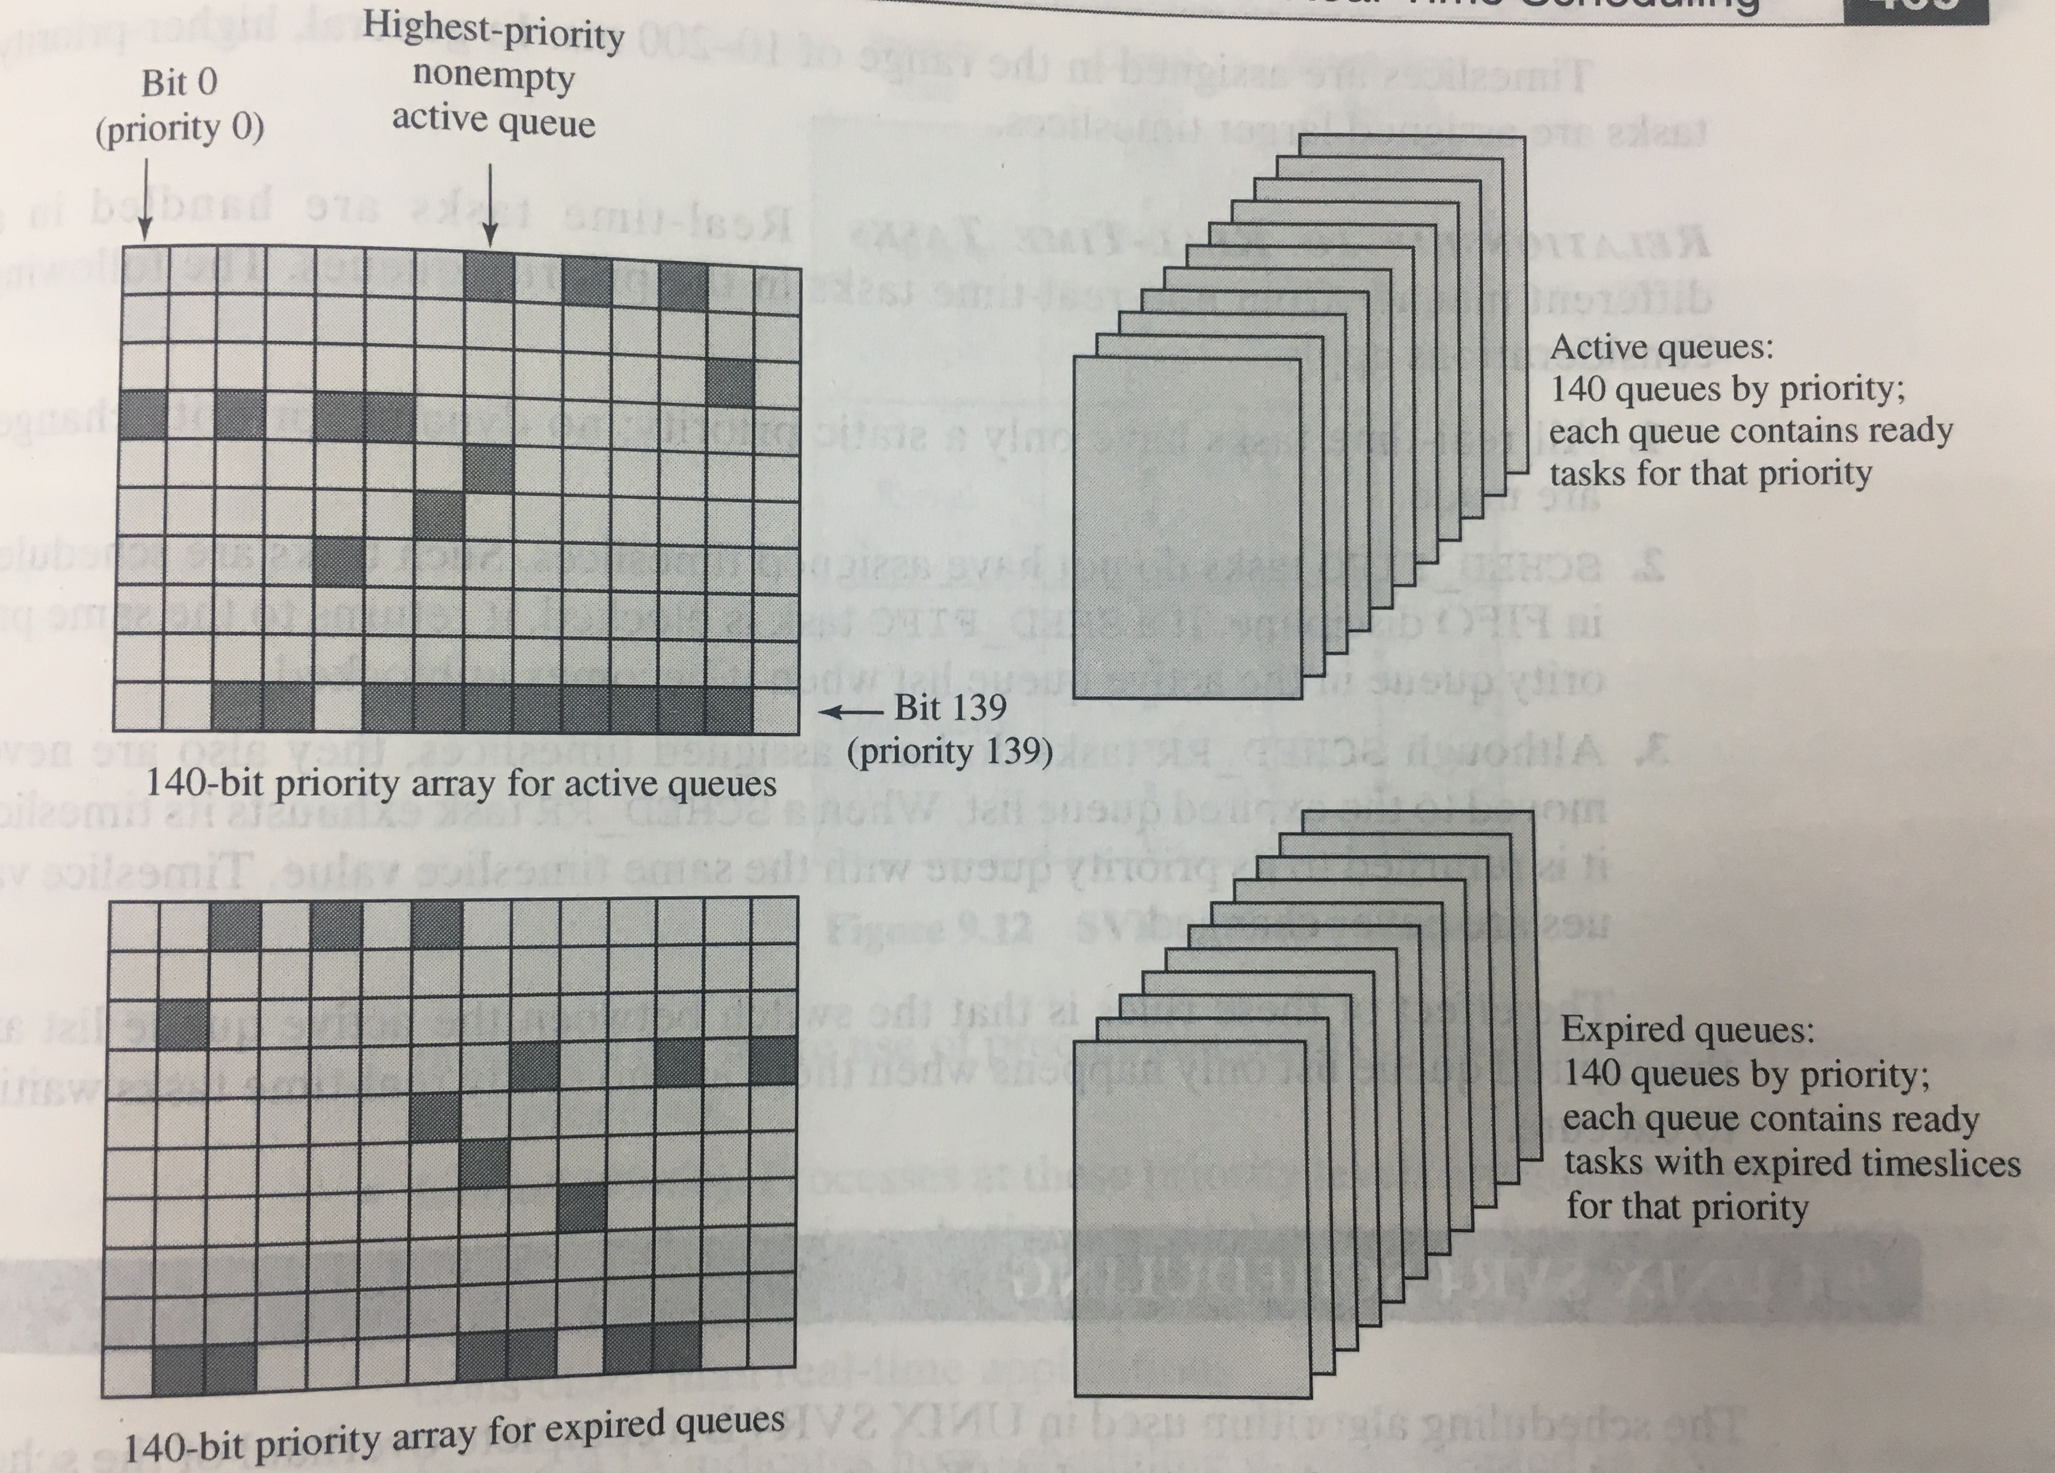
PART ONE
SCHED_OTHER／SCHED_NORAML
Linux2.6内核包含了两个调度队列，其结构体如下：
struct prio_array{
int nr_active; /*number of tasks in this array*/
unsigned long bitmap[BITMAP_SIZE]; /*priority bitmap*/
struct list_head queue[MAX_PRIO]; /*priority queues*/
};
当非实时进程timeout时，就将会移入expired queues，并重新计算时间片大小
只有当active queues空时，队列指针才会转移到expired queues
PLUS. 实时进程不会因为timeout而被移入expired queues
Figure Linux Scheduling Data Structures for Each Processor
Notes:
Bitmap是32bit的字，所以bitmap_size为5

Slide 8
PART TWO
Windows Scheduling

Slide 9
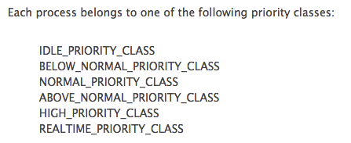
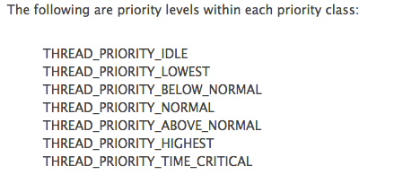
PART TWO
Windows Scheduling
Threads are the unit of scheduling in Windows rather than processes.
The priority levels range from zero (lowest priority) to 31 (highest priority).

Slide 10
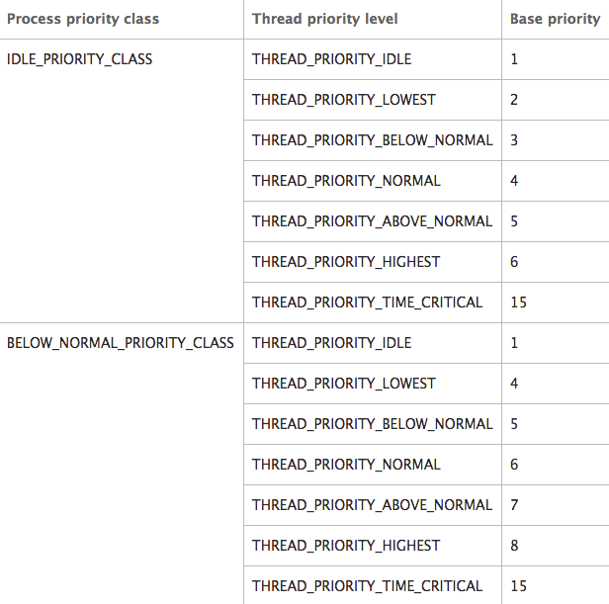
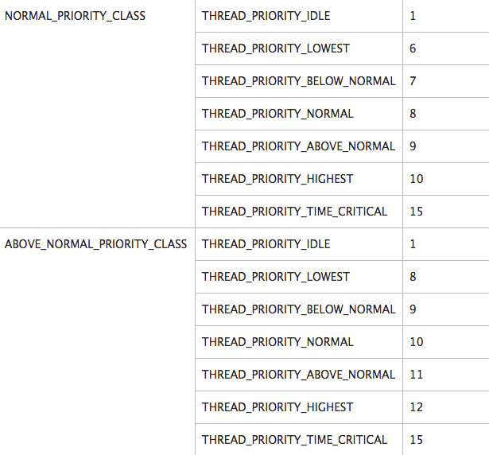
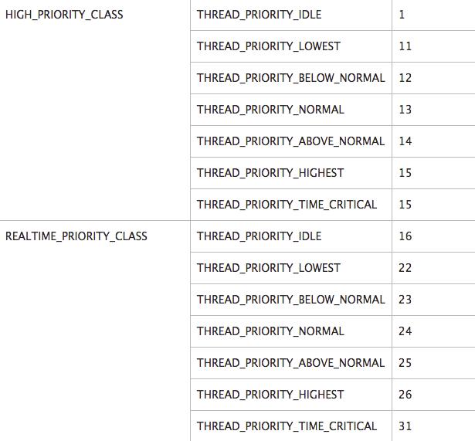
PART TWO
Figure Base Priority of Each Level

Slide 11
PART ONE
Windows Scheduling
RR
Each thread has a dynamic priority initialized with its base priority.
Only threads with a base priority between 0 and 15 receive dynamic priority boosts.
The system boosts the dynamic priority of a thread to enhance its responsiveness as follows.
When a process that uses NORMAL_PRIORITY_CLASS is brought to the foreground
When a window receives input
When the wait conditions for a blocked thread are satisfied
After raising a thread's dynamic priority, the scheduler reduces that priority by one level each time
the thread completes a time slice, until the thread drops back to its base priority. A thread's dynamic
priority is never less than its base priority.(PLUS. The difference with the textbook.)

Slide 12
PART THREE
Priority Inversion

Slide 13
PART Three
Priority Inversion
Consider a simple case with three threads: thread 1, thread 2, and thread 3.
Thread 1 is high priority and becomes ready to be scheduled. Thread 2, a low-priority thread, is executing code in a critical section. Thread 1, the high-priority thread, begins waiting for a shared resource from thread 2. Thread 3 has medium priority. Thread 3 receives all the processor time, because the high-priority thread (thread 1) is waiting for shared resources from the low-priority thread (thread 2). Thread 2 will not leave the critical section, because it does not have the highest priority and will not be scheduled.

Slide 14
PART Three
Solutions
任意增加ready threads的优先级 (在这个例子中，Thread 2)。
优先级继承，当一个高优先级进程等待一个低优先级进程持有的资源时，低优先级进程将暂时获得高优先级进程的优先级别。
优先级置顶协议（Priority Ceiling Protocol）:每个互斥体都被分配一个优先级，该优先级通常与所有可以拥有该互斥体的线程中的最高优先级。当优先级较低的线程占有互斥体后，该线程的优先级被提升到该互斥体的优先级。

Slide 15

参考文献
[1]William Stallings. Operating Systems Internals and Design Principles, Seventh Edition[M]. 北京:电子工业出版社, 2013.
[2] Daniel P Bovet. UNDERSTANDING THE LINUX KERNEL[M]. 北京:中国电力出版社, 2001.
[3] Microsoft. Scheduling Priorities[EB/OL]. https://msdn.microsoft.com/en-us/library/windows/desktop/ms685100(v=vs.85).aspx.
[4]刘钰峰. 现代操作系统调度策略研究[D]. 湖南大学. 2002.
[5] (美)Scott Maxwell著,冯锐等译. Linux内核源代码分析[M]. 机械工业出版社, 2000

Slide 16
THANK YOU
FOR WATCHING
PRESENTED BY Ian

